Slide 1


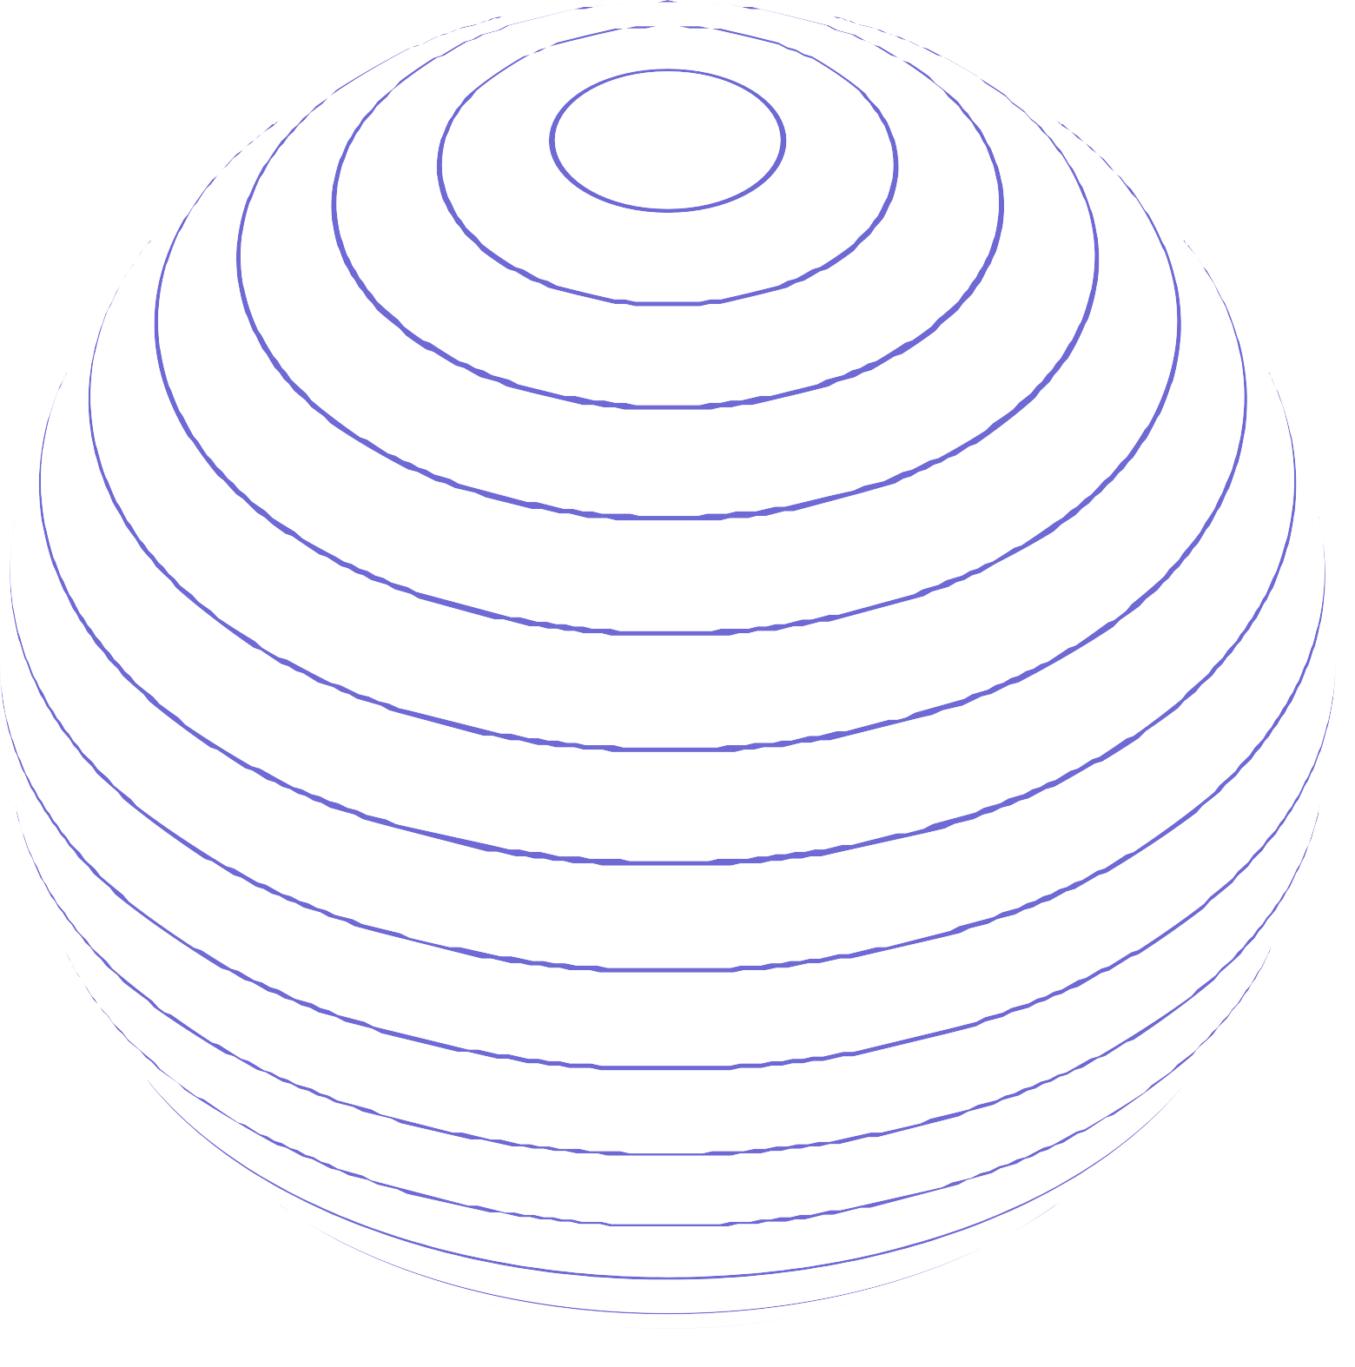
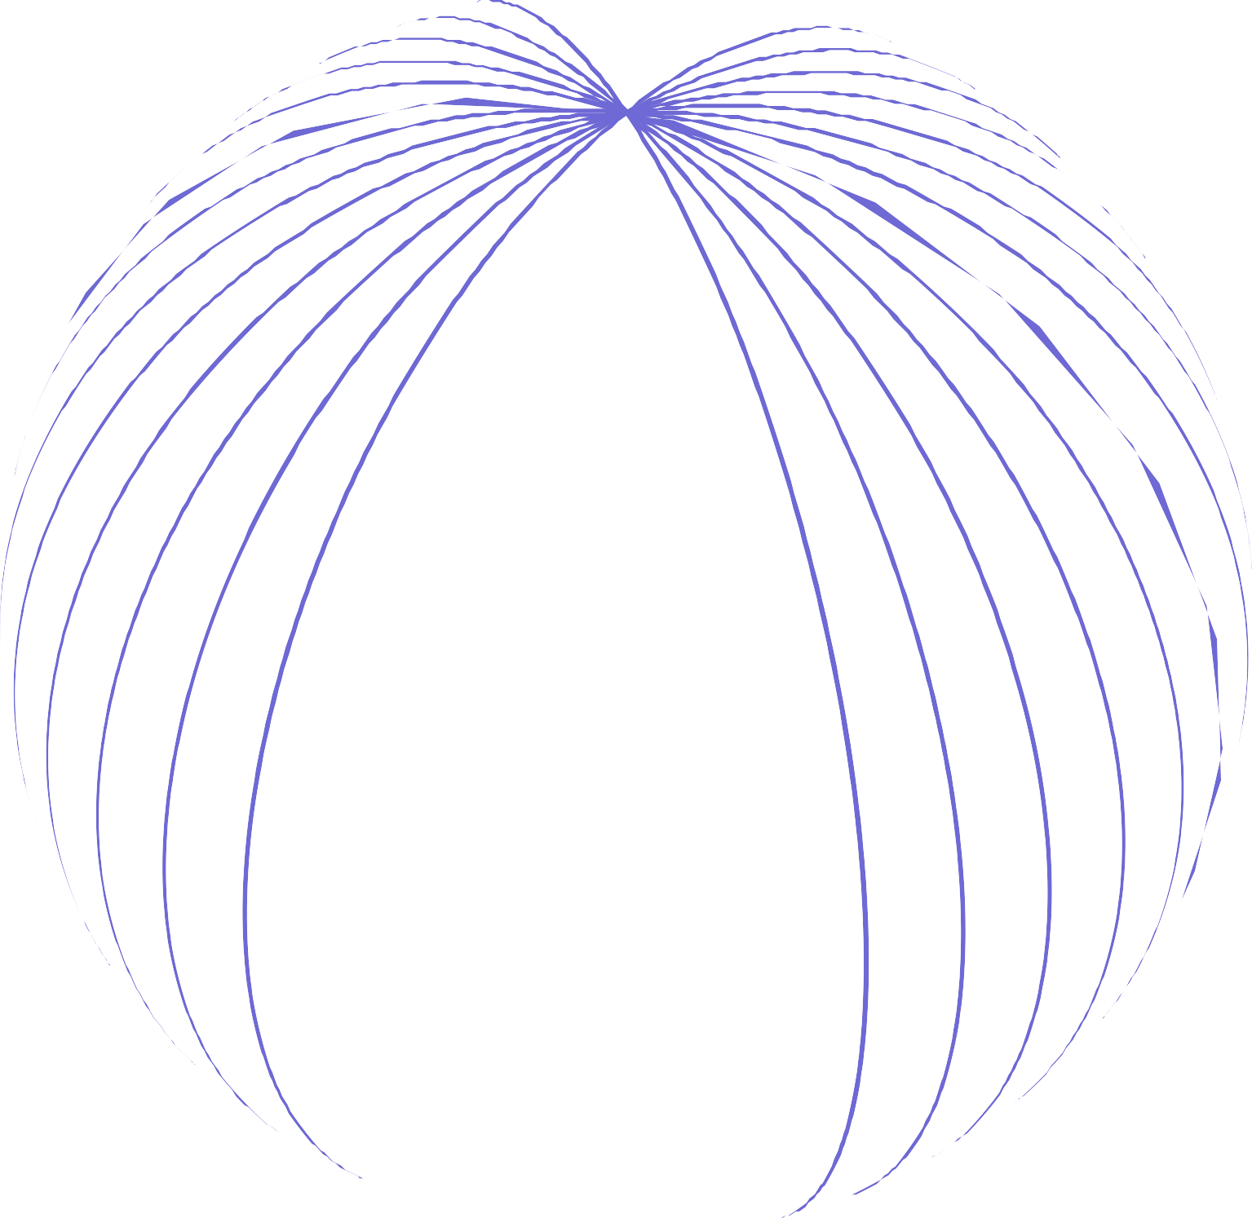
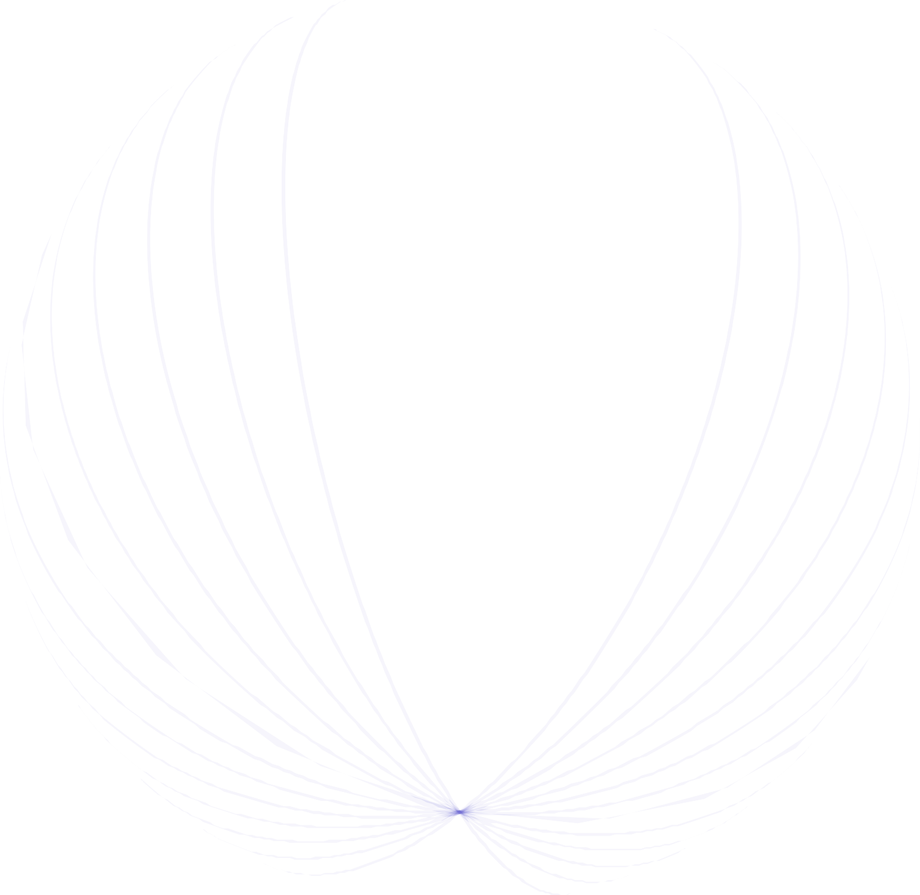
001
HAND GESTURE DETECTION
SIGN LANGUAGE DETECTION
S I G N L A N G U A G E D E T E C T I O N

Slide 2

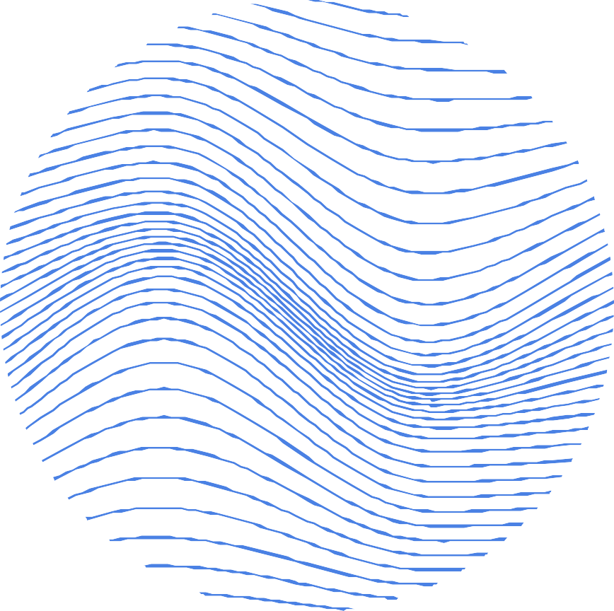
002
GROUP - 7
GROUP MEMBERS
JILL SHAH KHUSHEE VAKIL DHRUVI SHAH
- AU2040234
- AU2040242
- AU2040263
SIGN LANGUAGE DETECTION

Slide 3

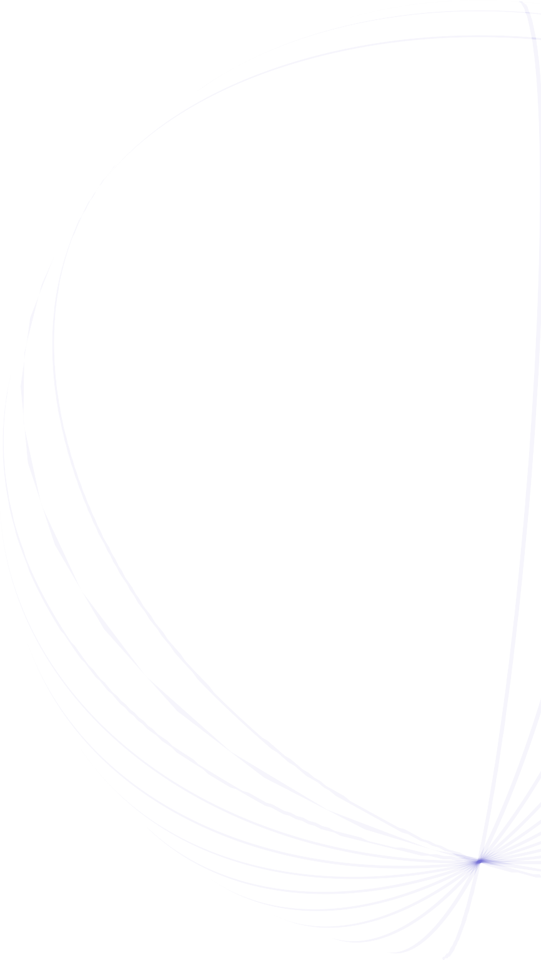
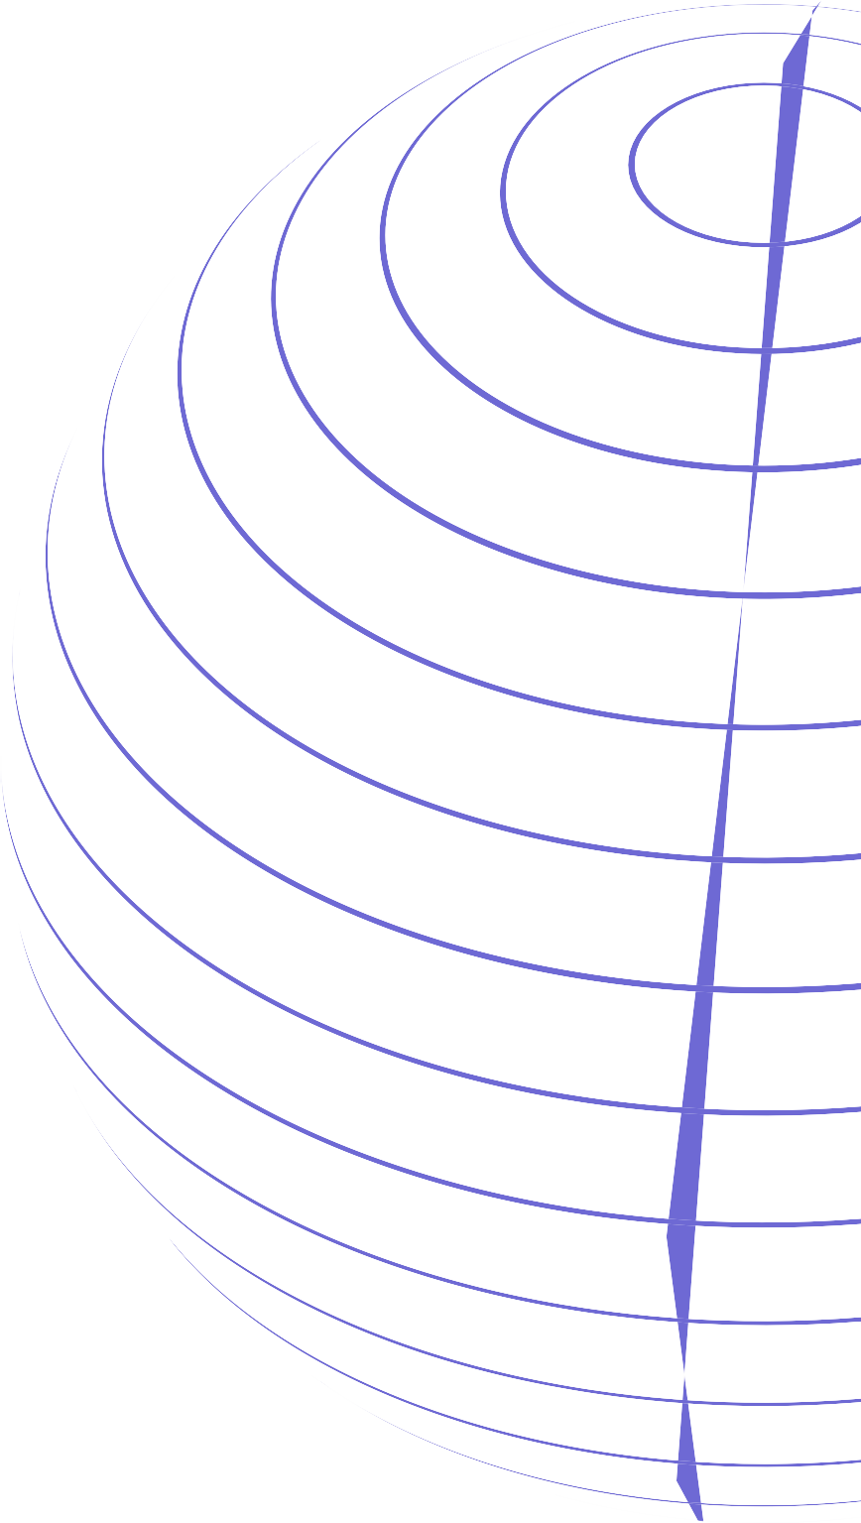
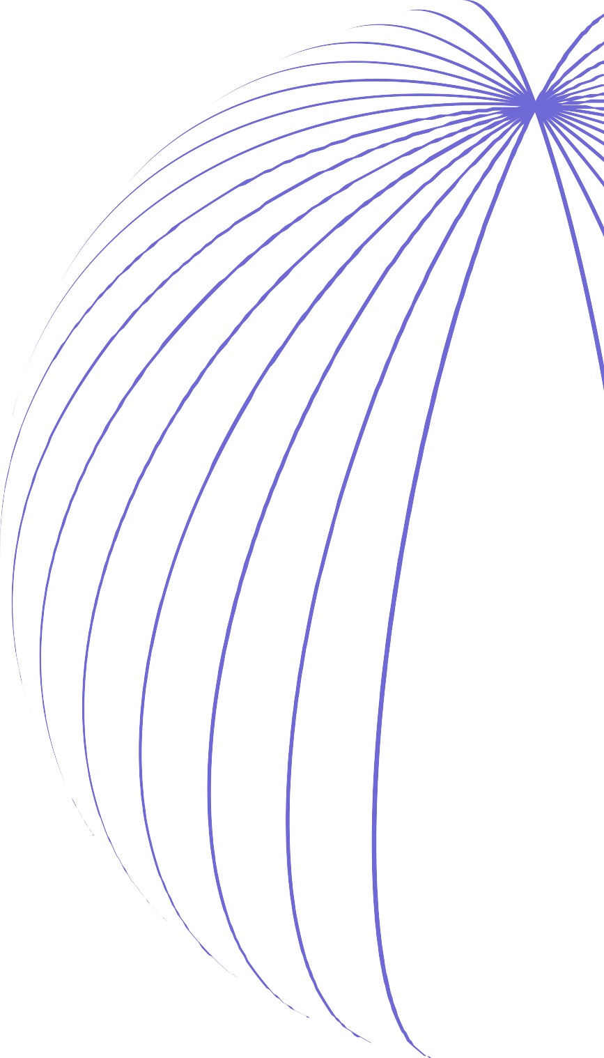


INTRODUCTION
003
The project aims to develop a hand sign language identification system using ResNet architecture to predict hand signs from loaded images after training on a dataset of 40500 hand sign images.
The primary objective is to accurately recognize hand gestures and translate them into text or speech.
SIGN LANGUAGE DETECTION

Slide 4
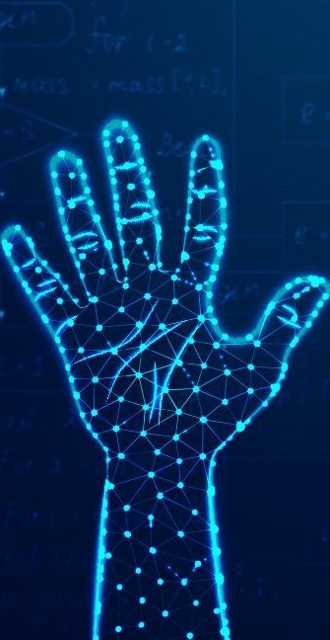
PROBLEM STATEMENT
004
Brief Introduction
The goal of this project is to develop a robust and accurate computer vision system that can accurately recognize and classify hand signs from loaded images.
Create a flexible system for recognising sign language motions for a range of hand gestures, postures, illumination, and backdrops.
SIGN LANGUAGE DETECTION

Slide 5

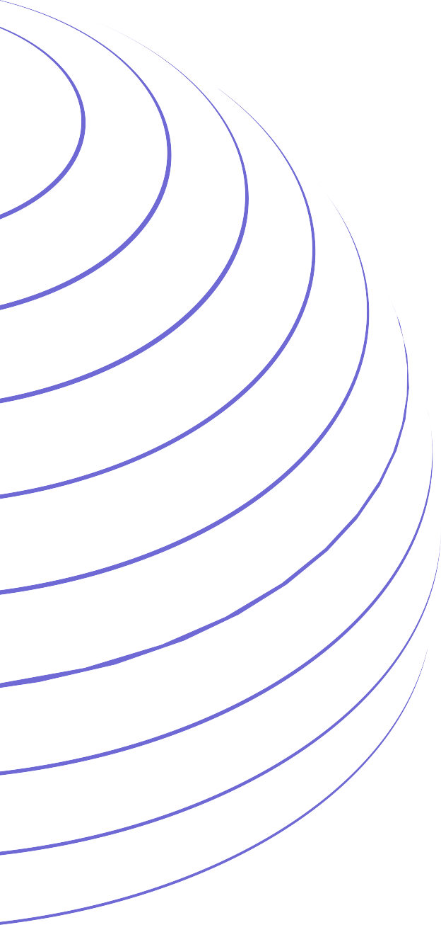
005
The "Sign Language Recognition" research paper proposes a two- step approach using deep learning for recognizing sign language gestures:
Detecting and tracking hand and fingers.
Using a trained CNN to classify hand and finger regions into different sign language gestures.
EXISTING BODY OF WORK
SIGN LANGUAGE DETECTION
Advanced models (MobileNetV2, LeNet-5) achieved promising 99.61% accuracy on test data.

Slide 6
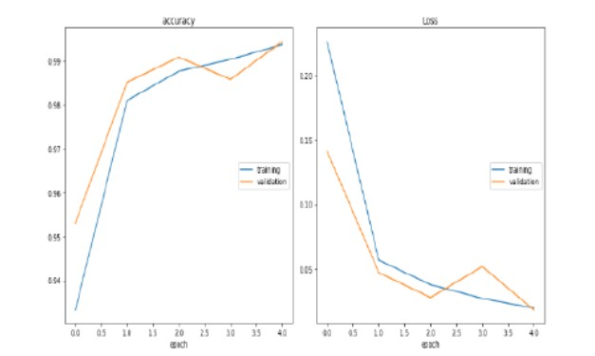




EXISTING BODY
OF WORK
006
SIGN LANGUAGE DETECTION

Slide 7
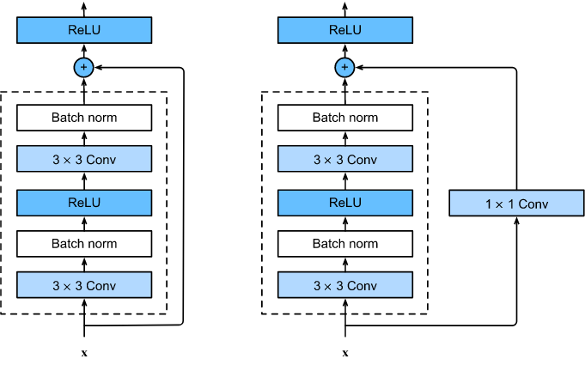


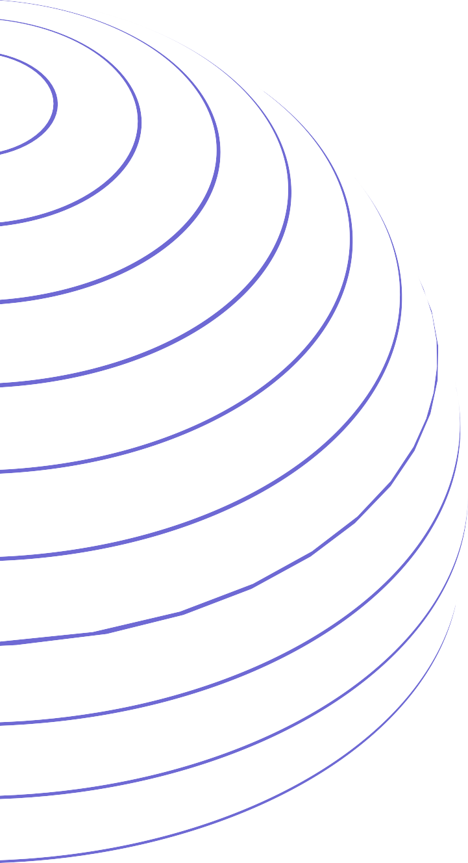
007
WHAT IS RESNET
ResNet is a popular deep learning architecture
used for capabilities
tasks like image due to residual
classification. It has superior feature extraction connections.
These connections prevent the vanishing gradient problem that can occur in deep neural networks with many layers.
The architecture consists of stacked convolutional layers, followed by a pooling layer and a fully connected layer.

Slide 8
008
OUR APPROACH
Collect a diverse dataset of hand gesture images for sign language recognition.
Preprocess the dataset by resizing, normalizing colors, and removing backgrounds.
Train a CNN-based deep learning model on the dataset.
Deploy the trained model and test its performance in various lighting conditions and backgrounds.
Make adjustments to the model or hardware/software setup to improve performance as needed.
SIGN LANGUAGE DETECTION

Slide 9
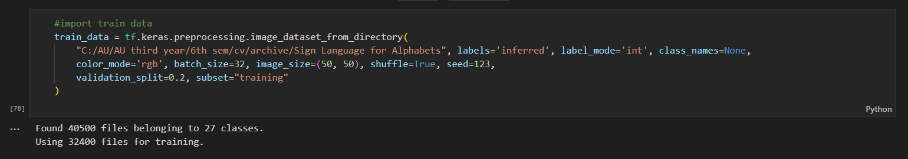
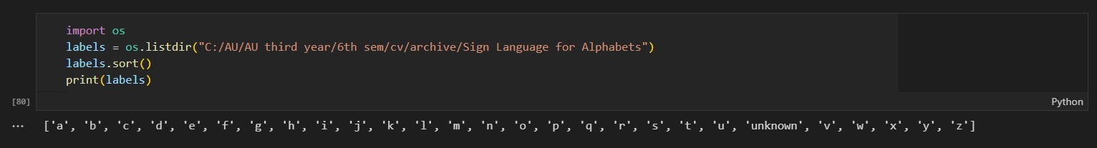
The following code snippets are about our dataset. Our dataset contains 27 classes with 1500 images in each. We have used the validation split of 0.2 which divided our dataset in a ratio of 80:20 of training to validation set.
There are 27 classes from a to z and one more class of unknown.

Slide 10
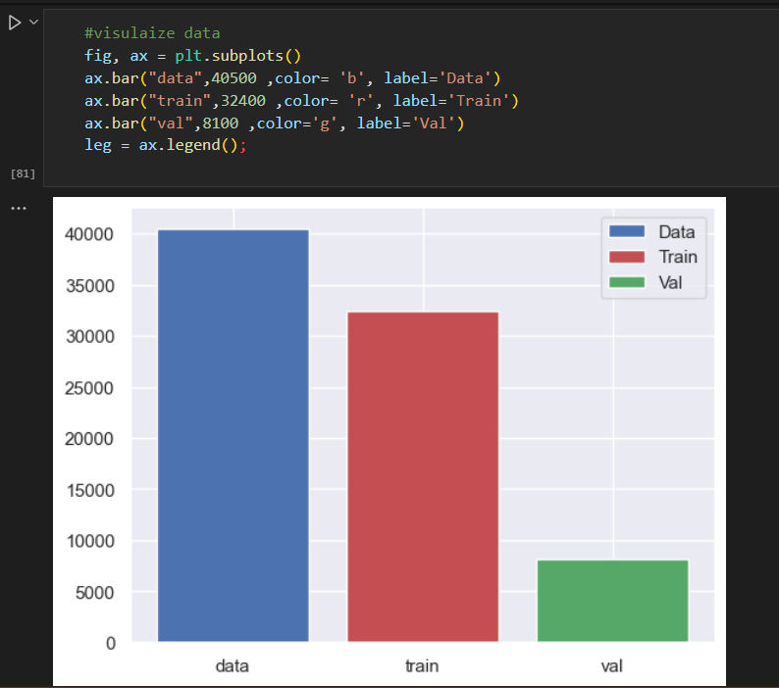
010
The following plotted graph shows the size of the dataset, training statset and the validation dataset after the validation split of 0.2
SIGN LANGUAGE DETECTION

Slide 11
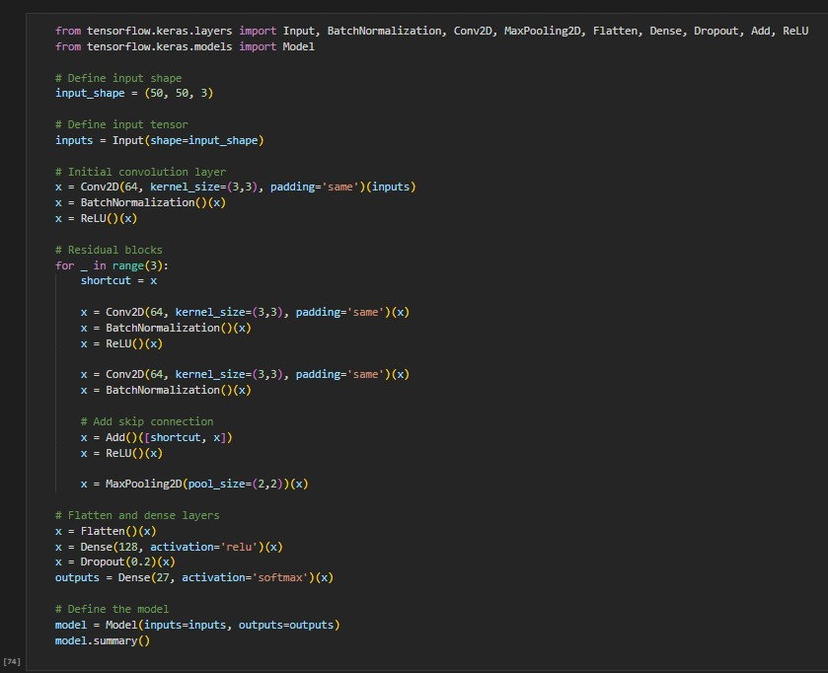
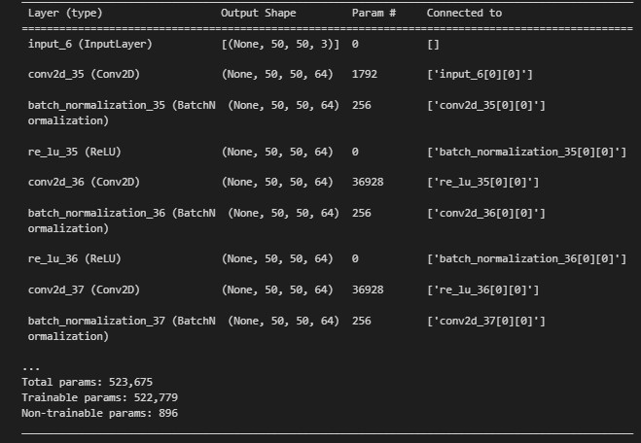
011
The code here showcases the resnet architecture that has been deployed using the residual blocks. The results of this code give us the total number of parameters and the trainable parameters

Slide 12
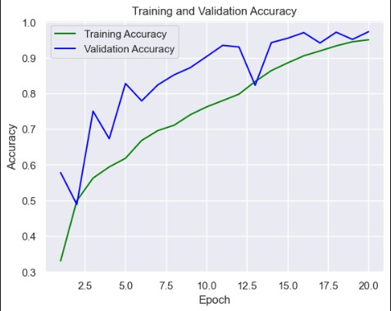
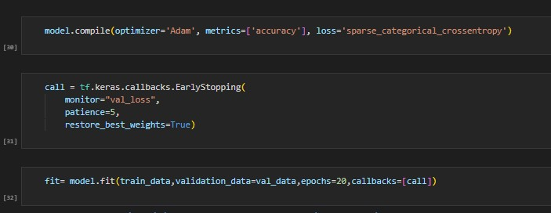
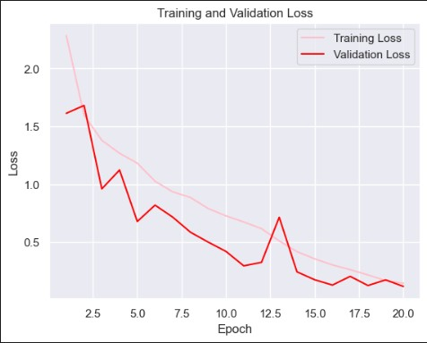
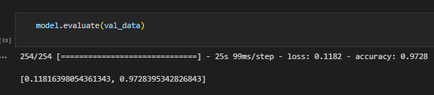
012
RESULTS
Our model has an adaptive learning rate and sparse categorical crossentropy loss function. On evaluating our data, our model gives us an accuracy of 97.28%.
SIGN LANGUAGE DETECTION

Slide 13
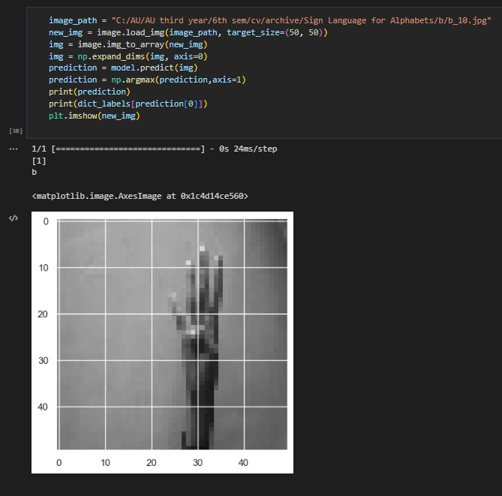
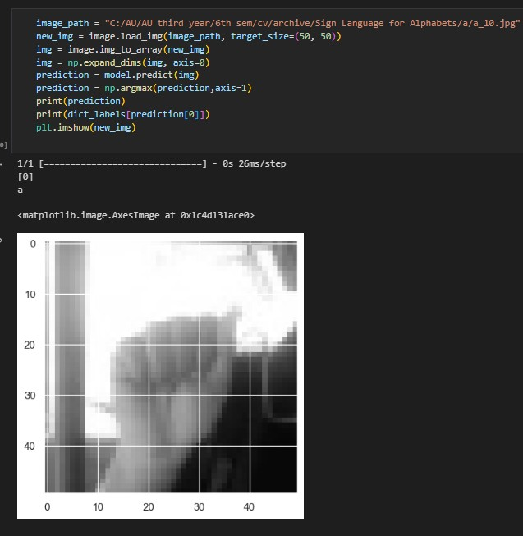
Our model is able to predict the sign language gestures in around 25 ms and with different lighting backgrounds
which shows the robustness of our model.
013
SIGN LANGUAGE DETECTION

Slide 14
SIGN LANGUAGE DETECTION
014

Slide 15



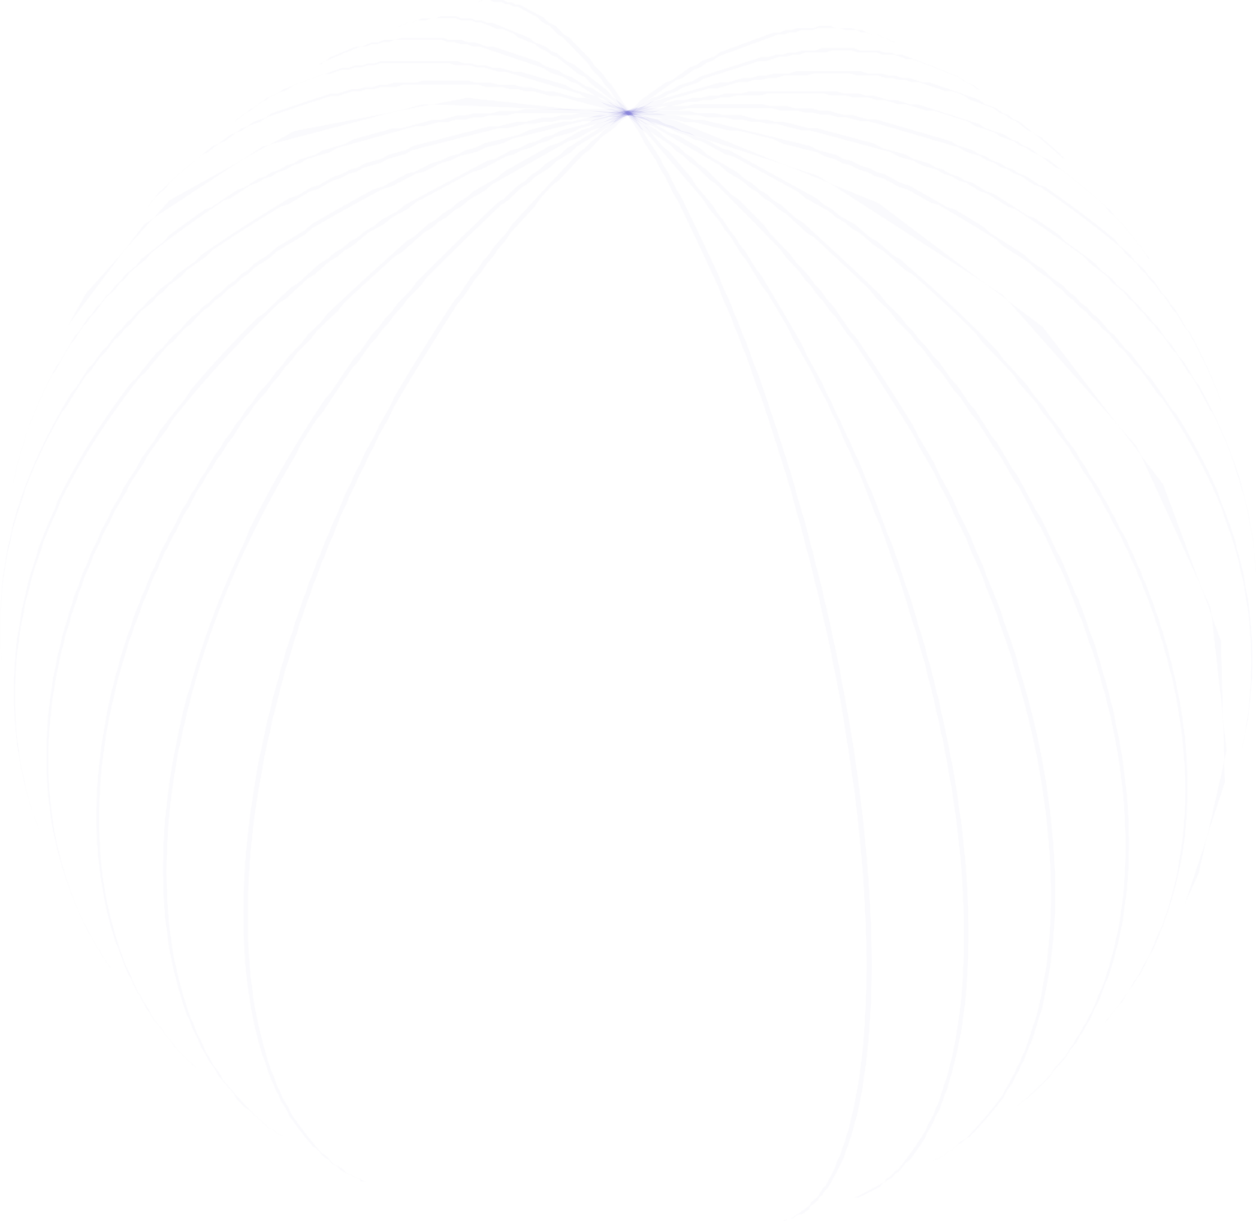

CONCLUSION
015
ROLE OF EACH GROUP MEMBER
JILL SHAH - implementation of the bounding boxes and displaying the output class till now.
KHUSHEE VAKIL - collecting dataset and information about the CNN algorithm.
DHRUVI SHAH - detecting hands and resizing the image to detect the gesture.
Training and testing of data is collectively done by all.
Our project uses ResNet architecture for computer vision to detect ASL alphabet signs.
Our ResNet-based hand sign language detection model achieves 97% accuracy on the test dataset, indicating its high performance in correctly identifying hand signs from uploaded photos.
SIGN LANGUAGE DETECTION

Slide 16





REFERENCES
Akash. (2018, April 22). Asl alphabet. Kaggle. Retrieved March 11, 2023, from https://www.kaggle.com/datasets/grassknoted/asl- alphabet
Kale, H. V., & Sonawane, R. S. (2021). Sign Language Recognition. Retrieved from ResearchGate: https://www.researchgate.net/publication/354066737_Sign_Lan guage_Recognition
Hand sign detection (ASL). Computer Vision Zone. (2022, July 4). Retrieved March 11, 2023, from https://www.computervision.zone/courses/hand-sign-detection- asl/
SIGN LANGUAGE DETECTION

Slide 17
THANK YOU

